Slide 1

MY Assignment PROJECT
RAJ SEKHAR ROY

Slide 2


INTRODUCTION
This data is a Retail Store Data. It shows who are the customers and what products they are buy and how they pay. It also shows customer reviews. This Data set has six Tables, they are Customers, Orders, Order_items, Products, Payments and Product_Reviews. Now I am helping what customer love to buy and how the business can improve and make profit higher.

Slide 3
TABLE STRUCTURE
COLUMN NAME | DESCRIPTION
Customer id | Unique id for each customer
Name | Full name of the customer
Email | Unique email address
Phone | Optional phone number
Created at | Account creation timestamp
COLUMN NAME | DESCRIPTION
Order id | Unique id for each customer
Customer id | Full name of the customer
Order date | Unique email address
Status | Optional phone number
Total Amount | Account creation timestamp
Table name - Customers
COLUMN NAME | DESCRIPTION
Product id | Unique Product id
Name | Name of the product
Category | Product Category
Price | Product Price
Stock Quantity | Units available in stock
Added on | Date product was added
Table name - Orders
Other Three Tables are Next Slide
Table name - Products

Slide 4
TABLE STRUCTURE
COLUMN NAME | DESCRIPTION
Payment id | Unique id for payment
Order id | Which order was paid for
Payment date | When payment was made
Amount paid | Amount paid
Method | Method (credit card, upi etc.)
COLUMN NAME | DESCRIPTION
Order item id | Unique id for each line item
Order id | Order to which item belongs
Product id | Which product was bought
Quantity | Quantity ordered
Item price | Snapshot of product price at order
COLUMN NAME | DESCRIPTION
Review id | Unique id for review
Product id | Which product is reviewed
Customer id | Who gave the review
Rating | Star rating
Review text | Review message
Review date | When the review was posted
Table name - Payments
Table name – Order Items
Table name – Product Reviews

Slide 5
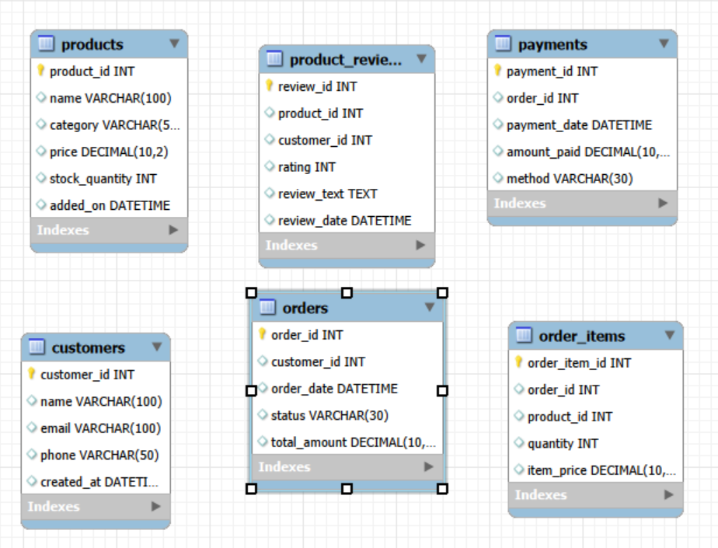
ER DIAGRAM FOR THIS DATA SET

Slide 6
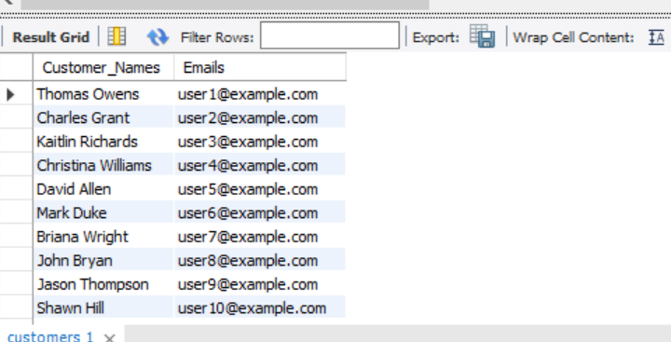
Retrieve customer names and emails for email marketing
QUESTION
OUTPUT
QUERY
HELP
This helps the marketing team extract basic customer contact details.

Slide 7
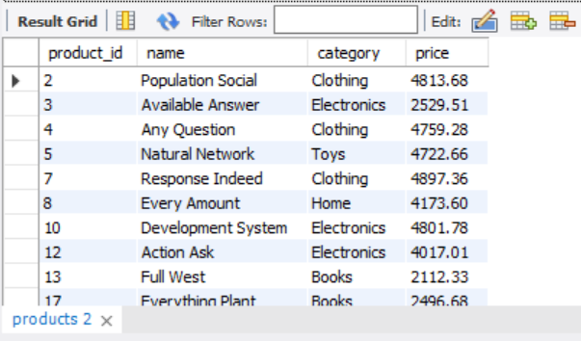
Display products within a mid-range price bracket (₹2,000 to ₹5,000)
QUESTION
OUTPUT
QUERY
HELP
It helps to create a mid-tier pricing campaign.

Slide 8
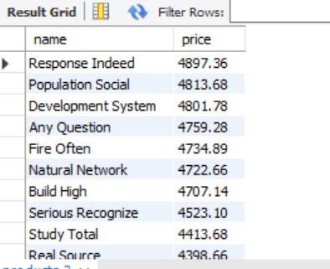
Display product names and prices in descending order of price
QUESTION
OUTPUT
QUERY
HELP
This helps teams easily view and compare top-priced items.

Slide 9
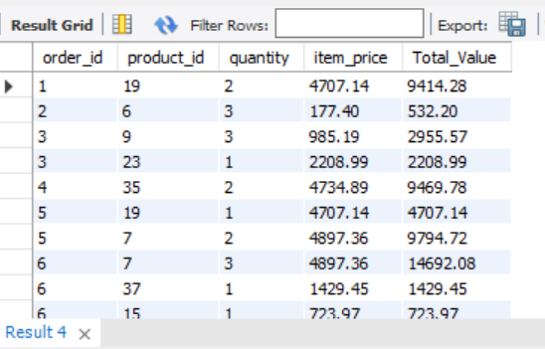
Calculate total value per item ordered by multiplying quantity and item price.
QUESTION
OUTPUT
QUERY
HELP
This can help generate item bill details or invoice breakdowns.

Slide 10
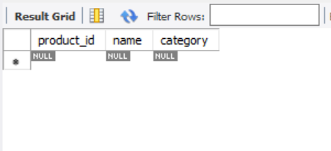
List products that do not have any stock left.
QUESTION
OUTPUT
QUERY
HELP
CONCLUTION
This helps the inventory team identify out-of-stock items.
There have No Products are Out of Stock. All Product are Available.

Slide 11
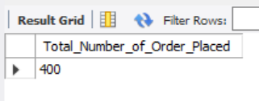
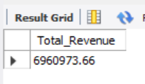
The total number of orders placed
QUESTIONS
The total revenue collected from all orders.
QUERY
OUTPUT
Used by business managers to track order volume over time.
This gives the overall sales value.
HELP

Slide 12

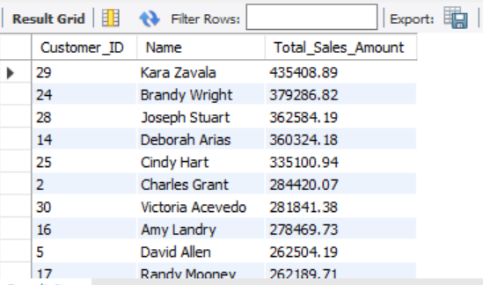
Find total sales amount made by each customer.
QUESTION
OUTPUT
QUERY
HELP
Its help to find Which Customers are Valuables.

Slide 13

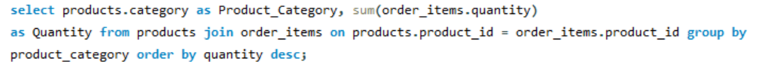
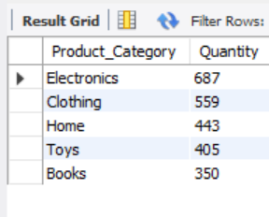
List the number of products sold per category.
QUESTION
OUTPUT
QUERY
HELP
This helps category managers assess performance by department.

Slide 14
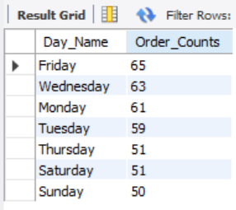
Show number of orders placed per day.
QUESTION
OUTPUT
QUERY
HELP
It used to track daily business activity and demand trends.

Slide 15
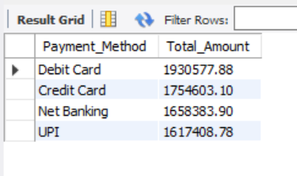
List total payments received per payment method.
QUESTION
OUTPUT
QUERY
HELP
Helps the finance team understand preferred transaction modes.

Slide 16

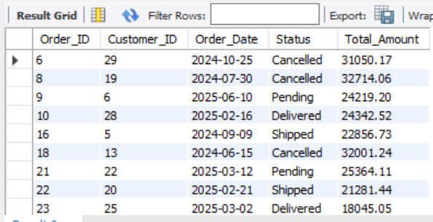
Show orders whose total amount is above the average for that customer .
QUESTION
OUTPUT
QUERY
HELP
Used to detect unusually high purchases per customer.

Slide 17

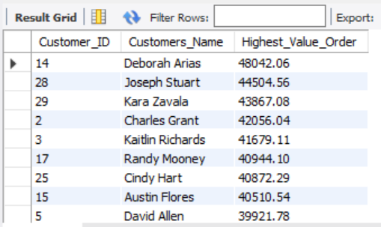
Highest Order Per Customer (Including Names)
QUESTION
OUTPUT
QUERY
HELP
Used to identify the largest transaction made by each customer. Outputs name as well.

Slide 18
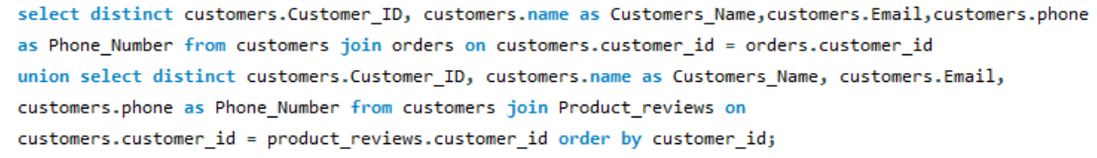
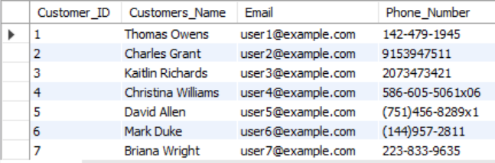
List all customers who have either placed an order or written a product review
QUESTION
OUTPUT
QUERY
HELP
Used to identify engaged customers from different activity areas.

Slide 19

SUMMARY
There are total revenue is 6960973.
There are 400 total number of order placed.
There are mid tier pricing customers are higher.
There are no products are out of stock. Means all products are available.
There are five customers who spent highest money between 300000 – 500000.
There high sold product category is Electronics product and then Clothing products.
Friday, Wednesday and Monday are the highest order placed per day.
There are highest payment received from Debit card and Credit card.
Customer name Deborah Arias who spent largest transaction.

